Slide 1
Capstone Project 2019
IOS Team
Technical Presentation

Slide 2
Requirements Engineering

Slide 3
Constraints
Time
Experience
The Client
&
Domain Knowledge
Notes:
Issues Faced:
Scope of requirements changed a lot
Lack of domain experience made it difficult to fully grasp the requirements at the beginning
Different team members had different understanding of the requirements and it was difficult to bring everyone on the same page
Many functional requirements depended on the technical constraints. Due to the technical unknowns, it was also ambiguous whether some requirements should be considered or not
Studying the requirements revealed further unknowns, which were not communicated to the customer during the meeting. The team had to wait till the next meeting to clarify those and it created a delay in the progress of the work
Prioritizing the requirements due to time, experience and technical constraints was hard to tackle: internally prioritized list didn’t confirm with the customer’s prioritization. It also caused delay.

Slide 4
Methodology & Lessons Learned
Requirements Engineers
Team
Client
Notes:
Efforts to resolve:
Tried focusing on the requirements we were sure about to get started with the work
Scheduled customer meetings and internal meetings to discuss the requirements to check for ambiguities
Tried acting out the scenarios to get a real sense of application usage, to get a better idea of the requirements
Watched videos regarding farming to better understand the context of problem statement
Used simulated environments and different applications to understand the context of application usage
Carried the ambiguities to the next customer meeting for clarification
What could have been improved?
Communication with the customer could have been regulated, or made more open
Technical constraints that were blockers to some requirements should have been communicated early on
Prioritization of the requirements could have been done early on with all the constraints considered
Scope should have been kept small from the very start considering the constraints
People experienced in the context of usage should have been contacted if possible for better understanding

Slide 5
Project Management (Responsibilities)
Use cases
Requirements
Architecture
Prototyping
Use case prototyping
API
Development

Slide 6
Project Management (Methodologies)
AGILE
Sprint
Scrum
GITLAB
Ticket
Kanban
REPOSITORY
Branch
Wiki

Slide 7
Project Management (Flow)
Ticket
Topic
Acceptance Criteria
Workflow
Project Manager
Task distribution
Roles
Expertise
Responsible Person
Developers
Developer
Tester
Project Manager

Slide 8
Project Management (Tools)
Daily scrum
Documentation
Communication
Pair programming

Slide 9
Project Management (Improvements)
Gitlab
CI/CD
Tags
Communication
Scrum
Retrospective
Ticket
Story point
Estimation
Timesheet

Slide 10
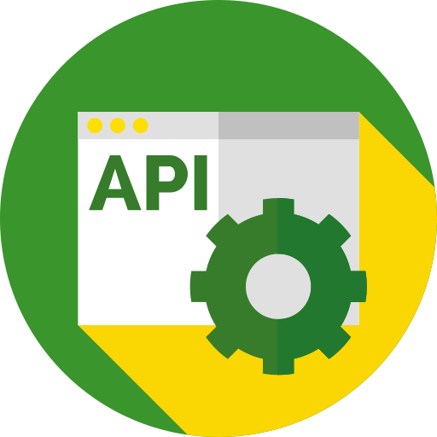

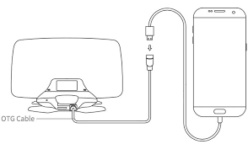
JD API Integration
JD API
JDOrganization
HTTP
JDField
...

Slide 11
JD API Integration: What we did?
Manual integration
JD Login
Show JDLogin screen and be able to authenticate
JD Framework
Framework in Objective-C is integrated into Swift app.
Alomofire for Swift
Could authenticate and fetch data
JD Organizations
Fetch list of organizations and and list of fields within an organization

Slide 12
JD API Integration: Challenges
JD API Documentation (README.md)
Technical implementation issues

Slide 13
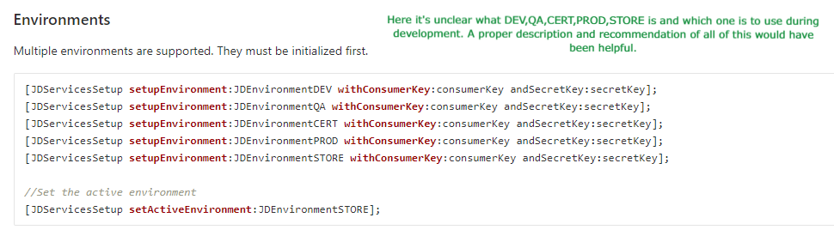
JD API Integration: Documentation issues

Slide 14
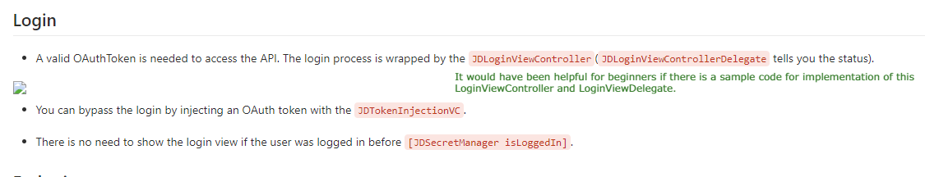
JD API Integration: Documentation issues

Slide 15
JD API Integration: Technical issues
JD Framework
In Objective-C
Swift and Mobile development experience
Nobody had Mobile Application development experience
Required bridging implementation
No prior knowledge of Swift

Slide 16
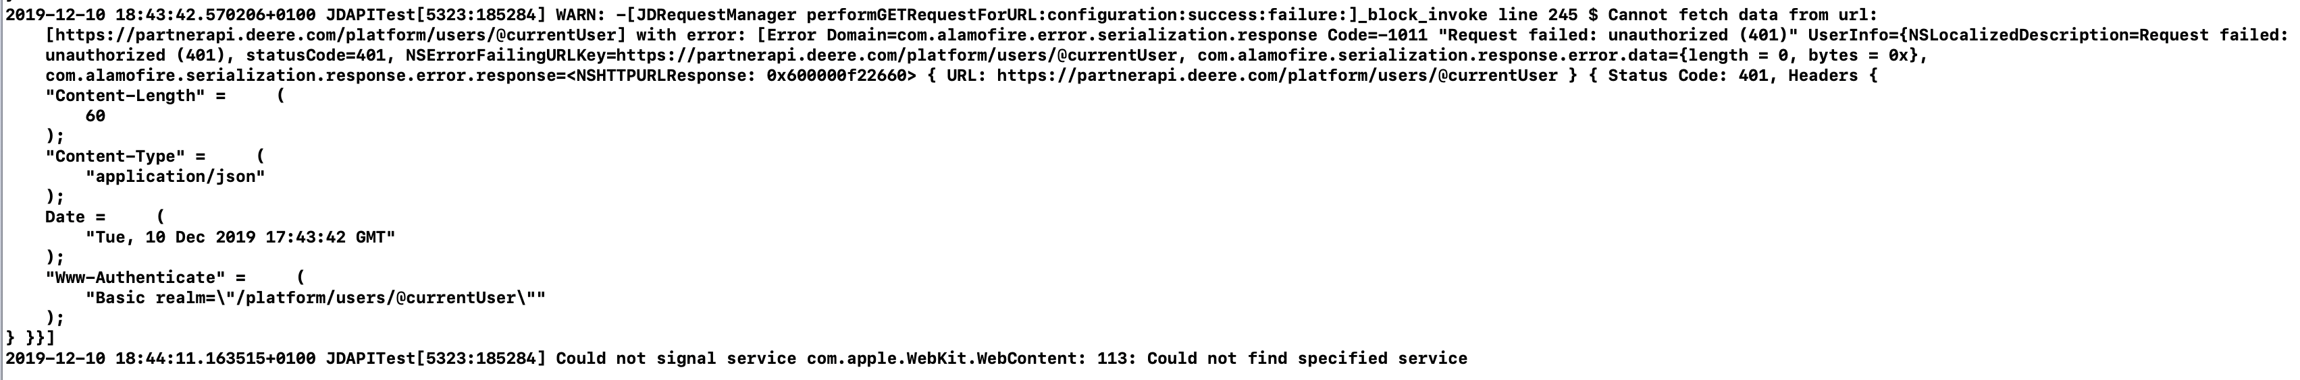
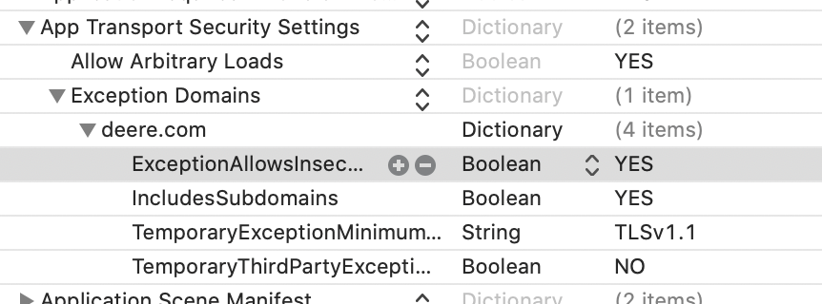
JD API Integration: Important Observations
JD Login
Default Storyboard must be deleted
JDLoginViewController initialized in SceneDelegate
Misleading Error messages
Probably bug of XCode

Slide 17
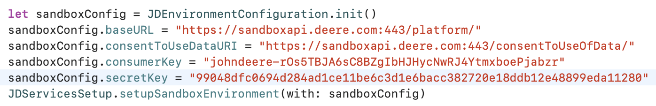
JD API Integration: Important Observations
JD fetch data

Slide 18
Quality Assurance & Testing

Slide 19
Quality Assurance & Testing: Our Approaches
Functional Testing
Non-Functional Testing
Quality Assurance
Code Quality
Performance Testing

Slide 20
Quality Assurance & Testing: System Testing
Robustness
Security
Performance
Code Quality
Reusability

Slide 21
Quality Assurance & Testing: Sample Test Case
TEST STEPS
INPUTS
EXPECTED OUTPUTS
ACTUAL OUTPUT
STATUS
LAST MODIFIED
Take a note
Connect JD Driver with car Ask Siri using voice command to take note. | User: “JD Driver take a note“ | Siri should ask for the field type Siri: “Of which type? Field or General“ | As expected | Pass | 06-12-2019
Connect JD Driver with car Ask Siri using voice command to take note. | User: “JD Driver testing and quality assurance“ | Siri: “ How can I help you with ?“ | As expected | Pass | 07-12-2019
Connect JD Driver with car Voice command for taking field type note | Siri: “Of which type? Field or General“ User: “field“ | Siri should ask the field name Siri: “For which field? Potato or Tomato field?“ | As expected | Pass | 07-12-2019
Connect JD Driver with car Voice command for taking field type note | Siri: “Of which type? Field or General“ User: “test field“ | Siri should ask the field name again Siri: “For which field? Potato or Tomato field?“ | As expected | Pass | 09-12-2019
Connect JD Driver with car Voice command for taking note on specific field. | Siri: “For which field? Potato field or Strawberry field?“ User: “Potato field“ | Siri: “Ok, tell me your note“ | As expected | Pass | 09-12-2019
Connect JD Driver with car Voice command for taking note on specific field. | Siri: “Ok, tell me your note“ | User: “remove tractor from potato field“ Siri should repeat the note and save it. | As expected | Pass | 09-12-2019
Connect JD Driver with car Voice command for taking note on specific field. | Siri: “For which field? Potato field or Strawberry field?“ User: “any field“ | Siri: “For which field? Potato field or Strawberry field?“ | As expected | Pass | 09-12-2019
Connect JD Driver with car Voice command for taking note on specific field. | Siri: “Ok, tell me your note“ User: “remove tractor from potato field“ | Siri: “You said ´remove tractor from potato field´, Do you want to save it? ” | As expected | Pass | 09-12-2019
Connect JD Driver with car Voice command for taking note on specific field. | Siri: “You said ´remove tractor from potato field´, Do you want to save it? | User: “yes” Note is saved on JD Driver | As expected | Pass | 09-12-2019
Take a note – Negative command
Take a field type note
Take a field type note – negative command
Take a note for the specific field
Take a note for the specific field
Take a note for the specific field – negative command
Save the note
Saved note

Slide 22
Quality Assurance & Testing: Summary
Achievements
Unit Testing
Difficulties
Environment
Pair programming
Time
Domain knowledge
80 % Success cases
Performance test
Code Quality

